Slide 1





Shock and Cosmic Ray Chemistry
in Supernova Remnant W28
Speaker: 涂天宇
Collaborators: 陈阳，周平
2023.7

Slide 2
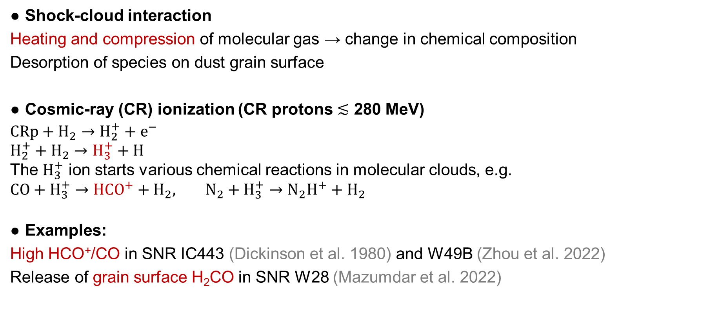
SNR-induced physics/chemistry in MCs
Shock-cloud interaction
Heating and compression of molecular gas → change in chemical composition
Desorption of species on dust grain surface
Cosmic-ray (CR) ionization (CR protons $≲$ 280 MeV)
$CRp+H_{2}→H_{2}^{+}+e^{−}$
$H_{2}^{+}+H_{2}→H_{3}^{+}+H$
The $H_{3}^{+}$ ion starts various chemical reactions in molecular clouds, e.g.
$CO+H_{3}^{+}→HCO^{+}+H_{2}, N_{2}+H_{3}^{+}→N_{2}H^{+}+H_{2}$
Examples:
High HCO⁺/CO in SNR IC443 (Dickinson et al. 1980) and W49B (Zhou et al. 2022)
Release of grain surface H₂CO in SNR W28 (Mazumdar et al. 2022)

Slide 3
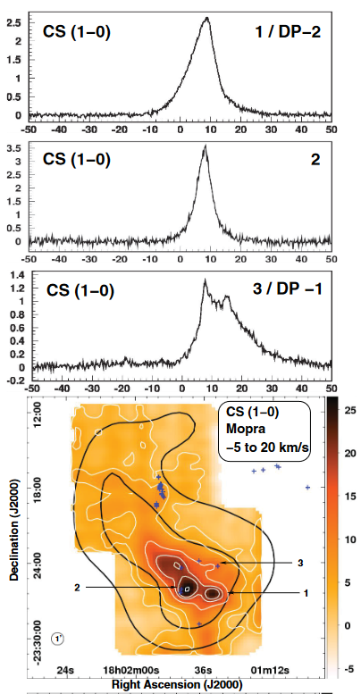
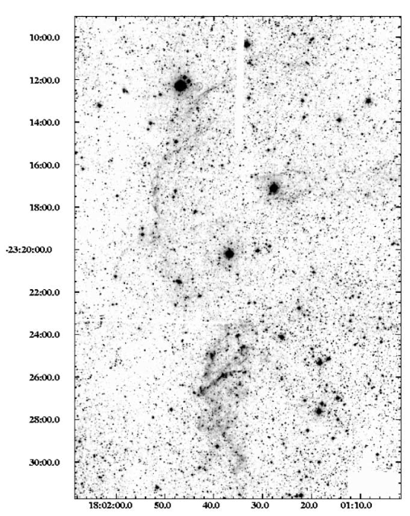
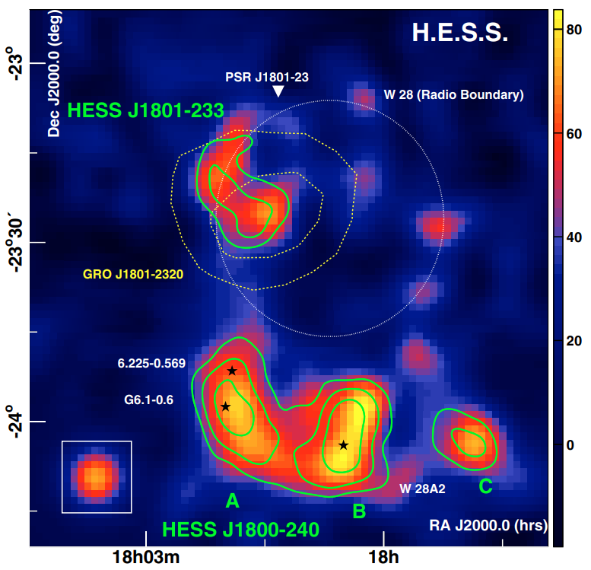
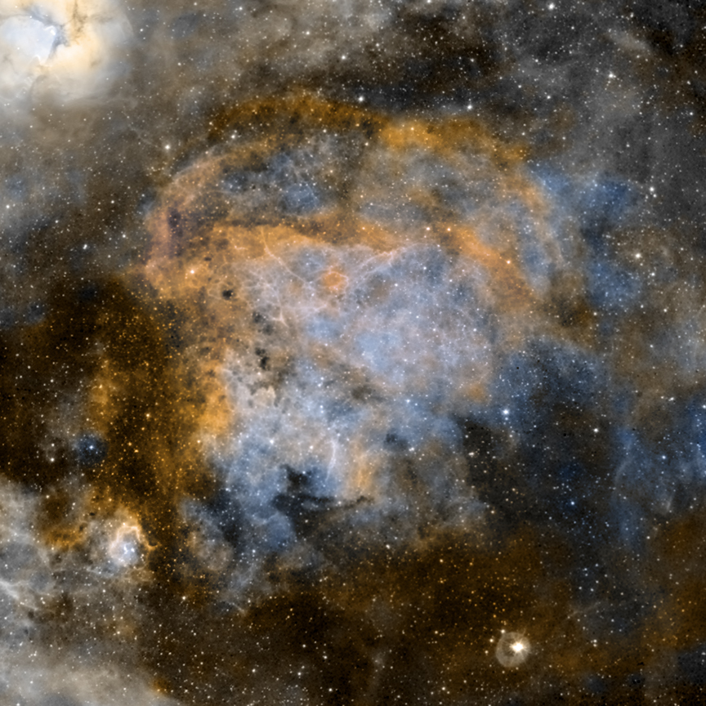
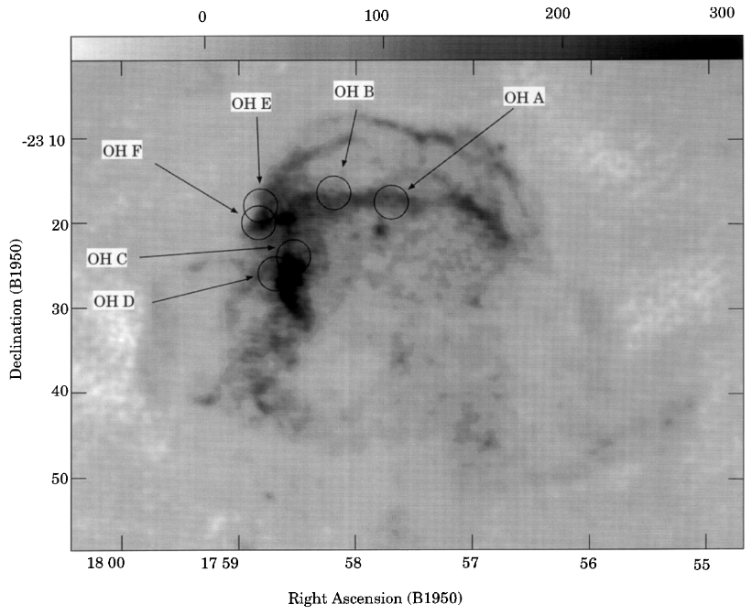
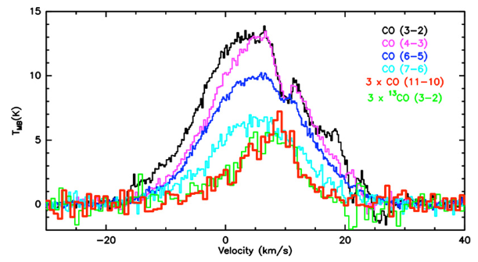
SNR W28
A typical SNR interacting with molecular cloud.
Age: ~33000 yr
Evidence of SNR-cloud interaction:
OH 1720MHz masers (Claussen et al. 1997)
H₂ 2.12μm filaments (Reach & Rho, 2005)
broad molecular lines (Nicholas et al. 2011, 2012)
high-J CO emissions (Gusdorf et al. 2008)
Evidence of CRs and CR-induced chemistry:
HESS & Fermi γ-ray detection (Aharonian et al. 2008)
High CR ionization rate ~ 10⁻¹⁵ s⁻¹ (Vaupré et al. 2014)
Detailed molecular chemistry in W28?
Gusdorf et al. 2008
Claussen et al. 1997
Optical: CTIO/P.F. Winkler et al.
X-ray: ROSAT
Radio: VLA/G. Dubner et al.
Reach & Rho 2005
Nicholas et al. 2012
Aharonian et al. 2008

Slide 4
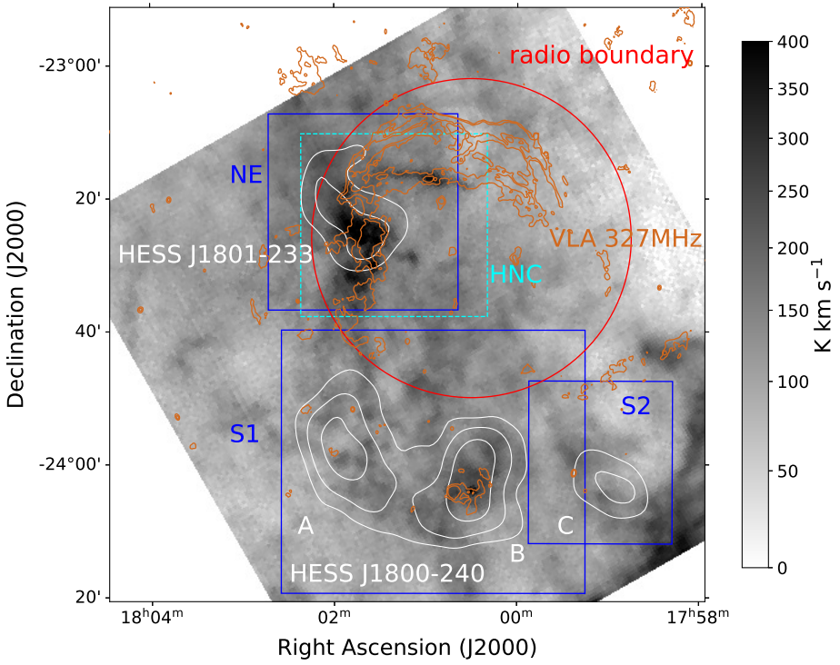
Observations
New observations:
PMOD 13.7m HCO⁺ HCN HNC J=1-0
Archival data:
MWISP: ¹²CO ¹³CO C¹⁸O
MALT90 survey: N₂H⁺ HCO⁺ H¹³CO⁺ J=1-0
Integrated intensity of ¹²CO (1-0) between -50 and 70 km/s

Slide 5
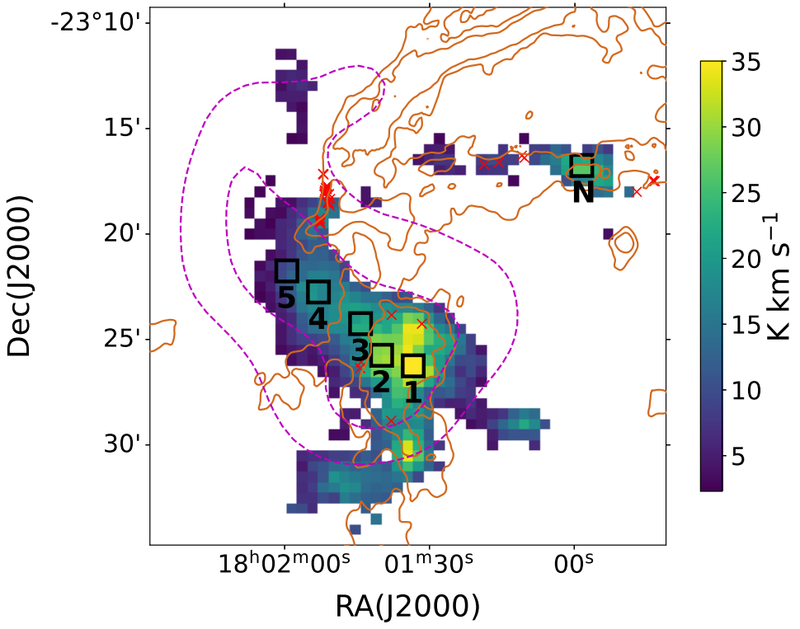
NE molecular cloud
Spatial distribution:
HCO⁺: coincident with radio continuum and HESS TeV γ-ray emission.
Exhibits unresolved clumpy structures along the radio continuum.
Distributions of HCN and HNC (not shown) are similar to that of HCO⁺.
Integrated intensity of HCO⁺ (1-0) between -30 and 40 km/s
Magenta contours: HESS TeV Orange contours: VLA 327MHz

Slide 6
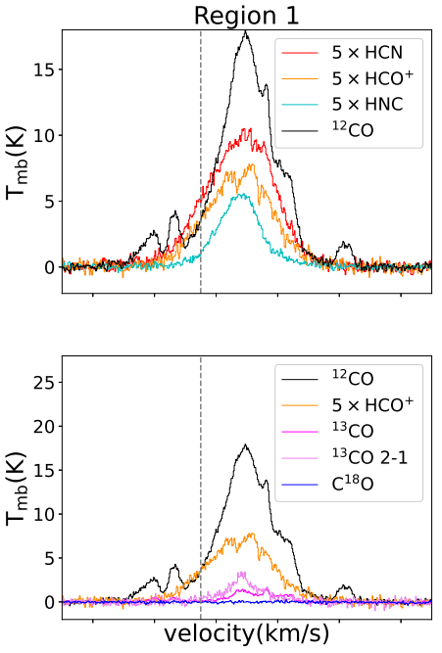
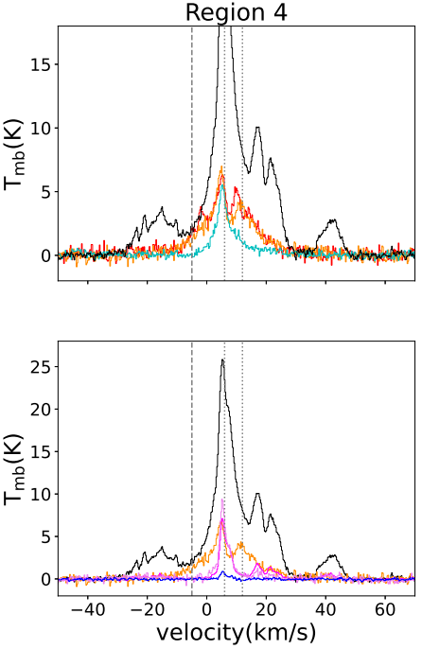
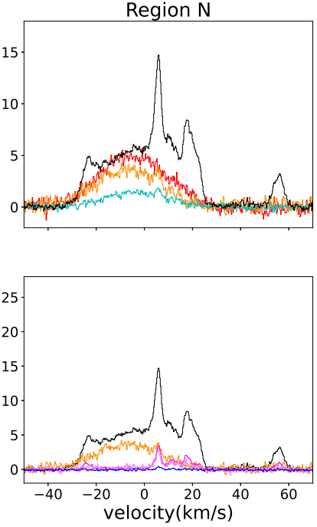
Spectra of NE molecular cloud
Broad lines with FWHM > 20km/s
Hyperfine structure of HCN is hidden in the broad emission line
Complicated ¹²CO line profiles

Slide 7
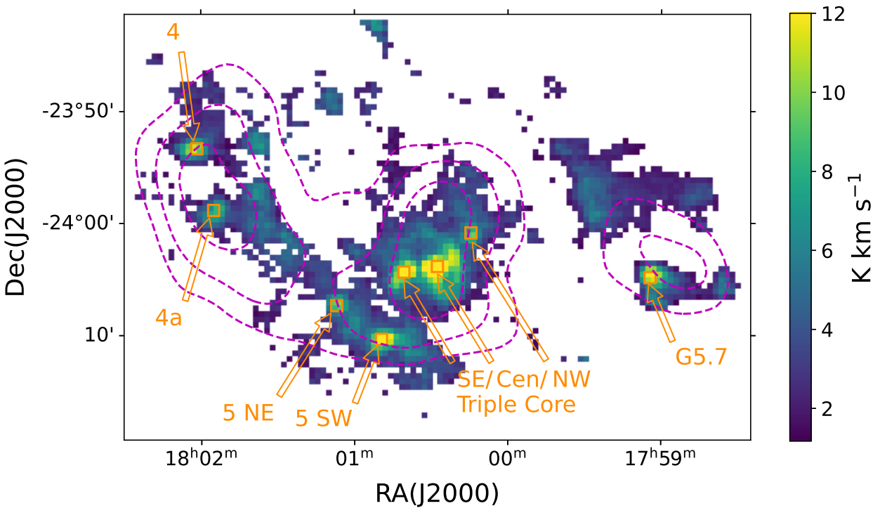
Southern molecular cloud
Clumpy structures with several star-forming regions, consistent with previous studies.
Integrated intensity of HCO⁺ (1-0) between 0 and 30 km/s
Magenta contours: HESS TeV

Slide 8
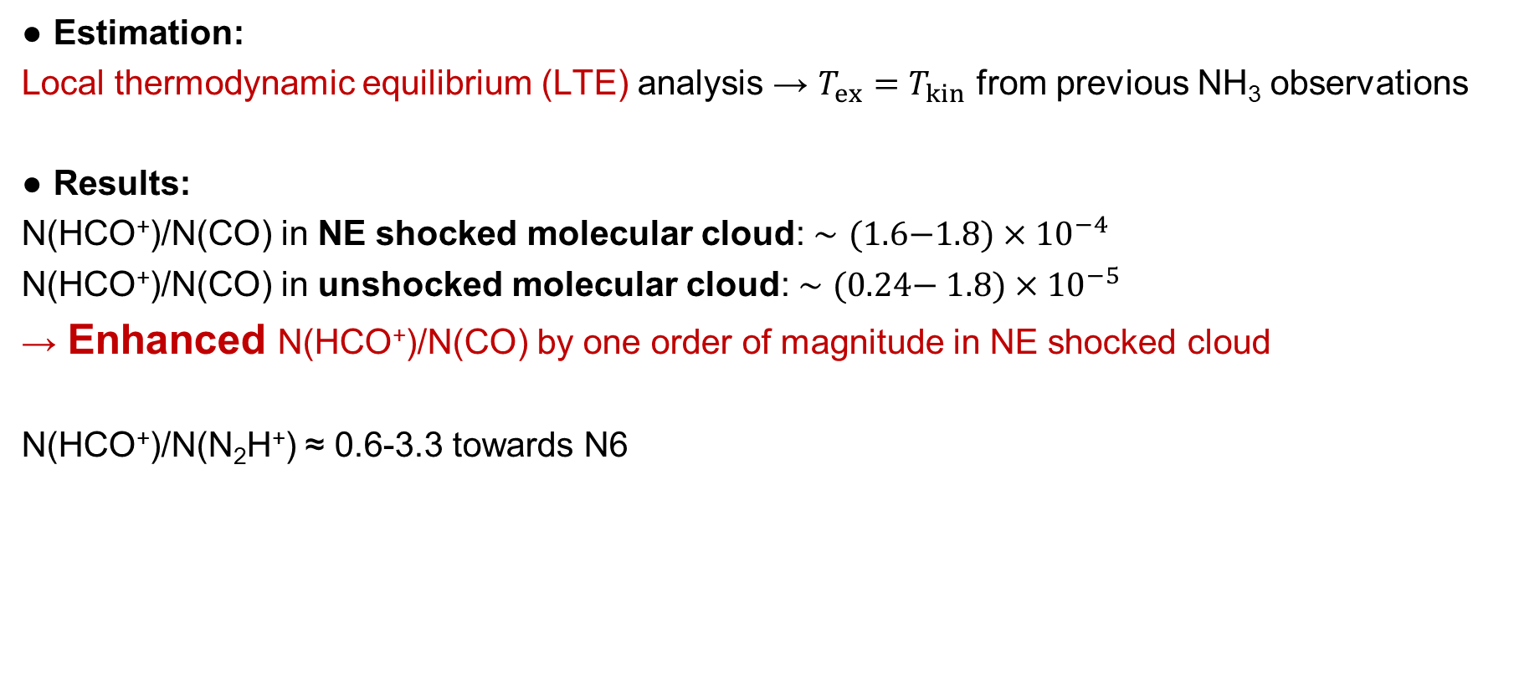
Molecular column densities
Estimation:
Local thermodynamic equilibrium (LTE) analysis → $T_{ex}=T_{kin}$ from previous NH₃ observations
Results:
N(HCO⁺)/N(CO) in NE shocked molecular cloud: $∼(1.6\text{−}1.8)×{10}^{−4}$
N(HCO⁺)/N(CO) in unshocked molecular cloud: $∼\text{(0.24− }1.8)×{10}^{−5}$
→ Enhanced N(HCO⁺)/N(CO) by one order of magnitude in NE shocked cloud
N(HCO⁺)/N(N₂H⁺) ≈ 0.6-3.3 towards N6

Slide 9
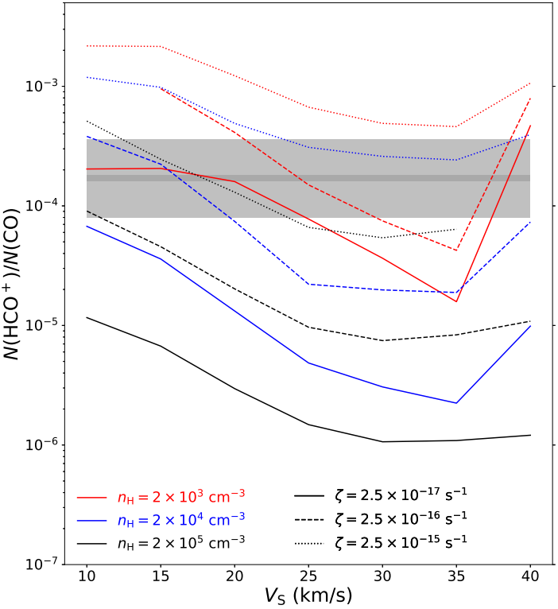
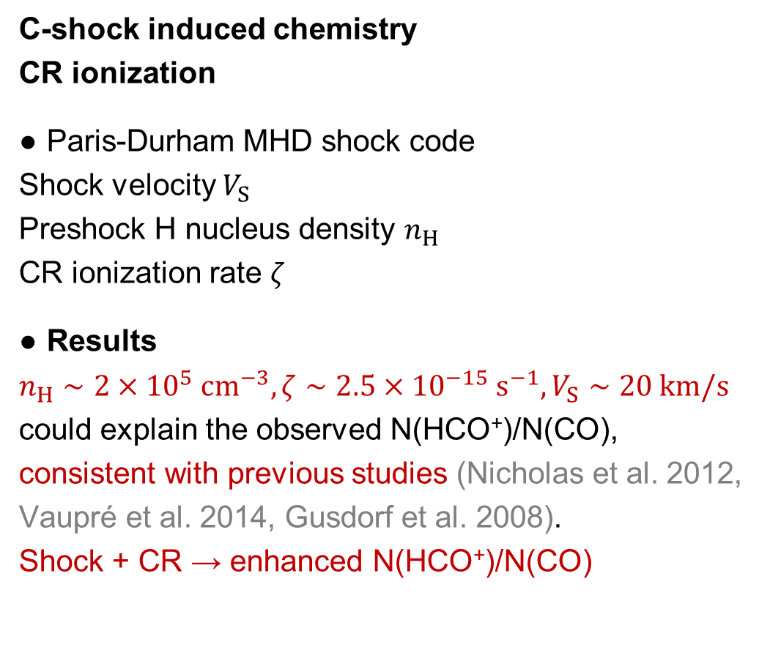
Why HCO⁺/CO enhanced?
C-shock induced chemistry
CR ionization
Paris-Durham MHD shock code
Shock velocity $V_{S}$
Preshock H nucleus density $n_{H}$
CR ionization rate $ζ$
Results
$n_{H}∼2×{10}^{5} cm^{−3}, ζ∼2.5×{10}^{−15} s^{−1}, V_{S}∼20 km/s$ could explain the observed N(HCO⁺)/N(CO), consistent with previous studies (Nicholas et al. 2012, Vaupré et al. 2014, Gusdorf et al. 2008).
Shock + CR → enhanced N(HCO⁺)/N(CO)
observation

Slide 10
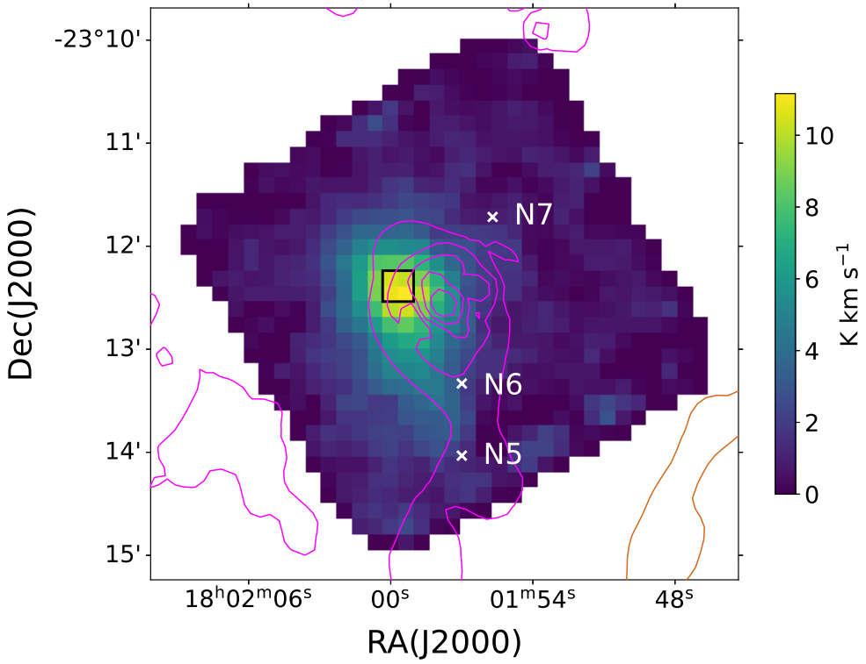
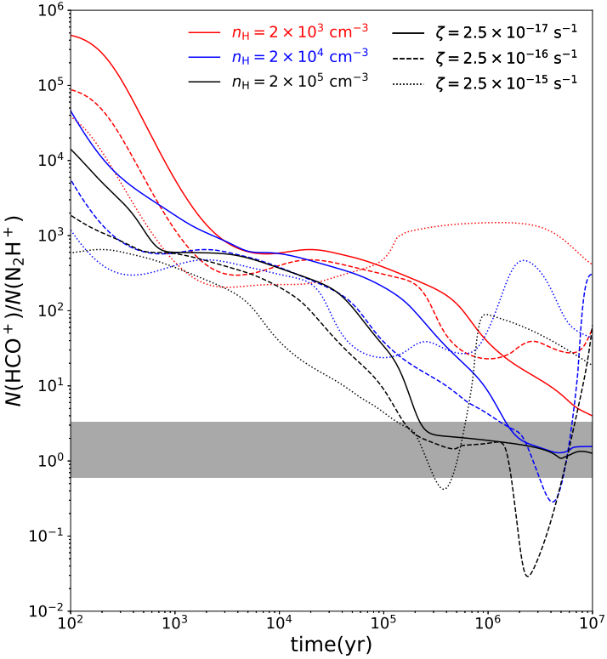
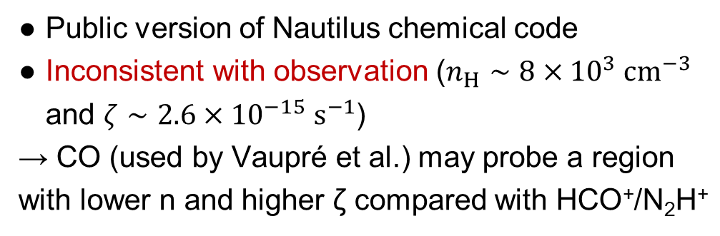
HCO⁺/N₂H⁺ abundance ratio
Towards N6
N(HCO⁺)/N(N₂H⁺)
≈ 0.6-3.3
MALT90
N₂H⁺
Fix T=13 K
Magenta contours: H₂ column density
Orange contours: VLA 327MHz
Public version of Nautilus chemical code
Inconsistent with observation ($n_{H}∼8×{10}^{3} cm^{−3}$ and $ζ∼2.6×{10}^{−15} s^{−1}$)
→ CO (used by Vaupré et al.) may probe a region with lower n and higher ζ compared with HCO⁺/N₂H⁺
observation
n_{H} ~ 2×10⁵ cm⁻³ or
n_{H} ~ 2×10⁴ cm⁻³ and ζ ~ 10⁽⁻¹⁷⁾ ⁻ ⁽⁻¹⁶⁾ s⁻¹

Slide 11
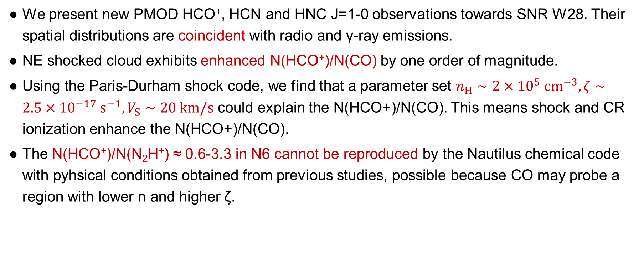
Conclusion
We present new PMOD HCO⁺, HCN and HNC J=1-0 observations towards SNR W28. Their spatial distributions are coincident with radio and γ-ray emissions.
NE shocked cloud exhibits enhanced N(HCO⁺)/N(CO) by one order of magnitude.
Using the Paris-Durham shock code, we find that a parameter set $n_{H}∼2×{10}^{5} cm^{−3}, ζ∼2.5×{10}^{−17} s^{−1}, V_{S}∼20 km/s$ could explain the N(HCO+)/N(CO). This means shock and CR ionization enhance the N(HCO+)/N(CO).
The N(HCO⁺)/N(N₂H⁺) ≈ 0.6-3.3 in N6 cannot be reproduced by the Nautilus chemical code with pyhsical conditions obtained from previous studies, possible because CO may probe a region with lower n and higher ζ.
Thank you for your listening!

